Slide 1
DAH2F3 Perencanaan Sumber Daya Perusahaan
Minggu ke-13: Process Modelling, Process Improvement, and ERP Implementation
P r o d i D 3 K o m p u t e r i s a s i A k u n t a n s i F I T , U n i v e r s i t a s T e l k o m

Slide 2
Process Modelling Process Improvement ERP Implementation

Slide 3
Process Modelling
Agar Proses Bisnis berjalan efektif dan efisien
Proses harus JELAS
Individu (pelaksana) harus terampil menjalankan PERANnya & paham proses bisnis secara keseluruhan
Proses Model (Flowcharting (Mobk, 2013), Business Process Modelling (Ray, 2011), Process Mapping (Ray, 2011))
“describe any abstract representation of a process” (Monk, 2013)
menggambarkan setiap bentuk abstrak dari proses
“A visual representation of different activities and steps of the process, data flows and input-output for different steps of the process” (Ray, 2011)

Slide 4
Process Modelling (Cont)
Penggambaran
Grafis representasi untuk lebih mudah dipahami
Contoh. Flowchart, BPMN, Activity Diagram
Siapa yang memodelkan proses
Sekelompok karyawan yang terlibat dalam proses
Mengapa berkelompol?
Mengurangi kesalahpahaman
Memastikan kesamaan pemahaman
Sumber: (Monk, 2013 Ch.7)
Notes:
Representasi Grafis biasanya lebih mudah dipahami daripada deskripsi tertulis, dan alat process modeling menyediakan cara untuk menggambarkan proses bisnis sehingga siapa pun yang melihat model dapat dengan mudah memahami proses.
Belajar BPMN http://resources.bizagi.com/docs/BPMNByExampleENG.pdf

Slide 5
Flowcharting Process Models
Flowcharting (atau Process Mapping)
Pemetaan aktivitas yang terjadi di dalam proses bisnis berjalan
Tujuannya
menunjukkan kelemahan aktivitas yang perlu dibenahi
Dengan melakukan gap analysis, yang merupakan penilaian kesenjangan antara bagaimana proses saat ini bekerja dan bagaimana organisasi ingin proses itu bekerja.
Sumber: (Monk, 2013 Ch.7)

Slide 6
Flowcharting Process Models
Mengapa diperlukan?
Bergambar dan mudah dipahami.
Menunjukkan aktivitas dalam proses dan langkah-langkah dalam aktivitas.
Menunjukkan relasi dan arus data antar proses yang dilakukan entitas organisasi
Mudah mengidentifikasi area pada proses berjalan.
Cepat membandingkan antara proses AS IS (berjalan) dan TO BE (usulan)
Mudah menelusuri dari scenario bisnis ke proses bisnis ke aktivitas dan ke langkah-langkah
Menjembatani gap antara orang IT dan orang Bisnis yang memiliki Bahasa komunikasi yang berbeda.
Sumber: (Ray, 2011, Ch. 10)

Slide 7
Contoh. Flowcharting Process Models
Maria is a Fitter salesperson who travels frequently for her job. After Maria incurs travel expenses on her personal credit card, she completes a paper expense report, makes a copy for her records, attaches receipts for any expenses over $25, and mails the report to her zone manager at the branch office.
The manager, Kevin, reviews the report and either approves it or mails it back to Maria with a note asking for an explanation, verification, or modification. Once Kevin approves the expense report, he mails it to the corporate office.
After the administrative assistant sorts the mail at the corporate office, she forwards the expense report to the accounts payable (A/P) clerk, who performs a preliminary check of the report. The clerk contacts Kevin for any necessary clarification, then forwards the expense report to the expense report auditor, who reviews it. If there is a problem with the report, the auditor mails it back to Maria, who revises it and returns it. Then the auditor enters the report into Fitter’s PC-based accounting system and files a hard copy with the receipts in a filing cabinet, organized by employee name.
At the end of each week, an A/P clerk uses the PC-based accounting system to print payroll checks, payments to suppliers, and expense reimbursement checks. When Maria receives her reimbursement check, she deposits it into her checking account and mails a payment to the credit card company, which credits her card account.
Temukan kata kerja untuk mengidentifikasi proses
Sumber: (Monk, 2013 Ch.7)

Slide 8
Contoh. Flowcharting Process Models Proses Penggantian Pengeluaran Bisnis Tenaga Penjualan
START
Employee prepares
expense report
Maria is a Fitter salesperson who travels frequently for her job. After Maria incurs travel expenses on her personal credit card, she completes a paper expense report, makes a copy for her records, attaches receipts for any expenses over $25, and mails the report to her zone manager at the branch office.
The manager, Kevin, reviews the report and either approves it or mails it back to Maria with a note asking for an explanation, verification, or modification. Once Kevin approves the expense report, he mails it to the corporate office.
After the administrative assistant sorts the mail at the corporate office, she forwards the expense report to the accounts payable (A/P) clerk, who performs a preliminary check of the report. The clerk contacts Kevin for any necessary clarification, then forwards the expense report to the expense report auditor, who reviews it. If there is a problem with the report, the auditor mails it back to Maria, who revises it and returns it. Then the auditor enters the report into Fitter’s PC-based accounting system and files a hard copy with the receipts in a filing cabinet, organized by employee name.
At the end of each week, an A/P clerk uses the PC-based accounting system to print payroll checks, payments to suppliers, and expense reimbursement checks. When Maria receives her reimbursement check, she deposits it into her checking account and mails a payment to the credit card company, which credits her card account.
Employee copies
report and receipts
Proses Pelaporan
Pengeluaran
Employee attaches
receipts for all
expenses > $25
Employee mails
expense report to
sales manager
Employee modifies
expense report
Sales manager
reviews report
Sales manager
mails report back
to employee
Apv?
Sales manager mails
expense report to
corporate office
1
Sumber: (Monk, 2013 Ch.7)
Proses Pelaporan Pengeluaran
Notes:
Narasi warna abu-abu, dapat dilanjutkan dari ‘connection symbol” (1)

Slide 9
1. Define process boundaries
Menentukan batas-batas proses
mendefinisikan kegiatan yang harus dimasukkan dalam proses, dan yang dianggap sebagai bagian dari lingkungan eksternal untuk proses tersebut.
Jika tidak menentukan batas proses
proyek meluas ke titik di mana ia dapat menjadi tidak terkendali.
Sumber: (Monk, 2013 Ch.7)

Slide 10
1. Define process boundaries Proses Penggantian Pengeluaran Bisnis Tenaga Penjualan
Maria is a Fitter salesperson who travels frequently for her job. After Maria incurs travel expenses on her personal credit card, she completes a paper expense report, makes a copy for her records, attaches receipts for any expenses over $25, and mails the report to her zone manager at the branch office.
The manager, Kevin, reviews the report and either approves it or mails it back to Maria with a note asking for an explanation, verification, or modification. Once Kevin approves the expense report, he mails it to the corporate office.
After the administrative assistant sorts the mail at the corporate office, she forwards the expense report to the accounts payable (A/P) clerk, who performs a preliminary check of the report. The clerk contacts Kevin for any necessary clarification, then forwards the expense report to the expense report auditor, who reviews it. If there is a problem with the report, the auditor mails it back to Maria, who revises it and returns it. Then the auditor enters the report into Fitter’s PC-based accounting system and files a hard copy with the receipts in a filing cabinet, organized by employee name.
At the end of each week, an A/P clerk uses the PC-based accounting system to print payroll checks, payments to suppliers, and expense reimbursement checks. When Maria receives her reimbursement check, she deposits it into her checking account and mails a payment to the credit card company, which credits her card account.
Lihat kembali Proses Pelaporan Pengeluaran
Proses terkait pengeluaran bisnis yang dianggap diluar batas, karena Proses Pelaporan Pengeluaran dimulai setelah biaya perjalanan telah terjadi, dan berakhir penerimaan pengembalian dana.
Cth. Proses diluar batas. Fitter might provide cash advances or issue corporate credit cards for travel expenses. Employees might need to make reservations for air travel or hotels through a corporate travel office. The company might require employees to use a preferred hotel, or it might have specific policies regarding car rentals, including preferred rental companies, approved car classes, insurance, and prepaid gas.
Semua proses harus memiliki hanya satu mulai titik dan satu titik akhir
Proses Pelaporan
Pengeluaran
Sumber: (Monk, 2013 Ch.7)
Notes:
Narasi warna abu-abu, dapat dilanjutkan dari ‘connection symbol” (1)

Slide 11
2. Hierarchical modeling
adalah jenis pemetaan proses di mana sebuah proses bisnis dapat digambarkan secara lebih atau kurang detail, tergantung pada pekerjaan yang ditugaskan
Sumber: (Monk, 2013 Ch.7)

Slide 12

2. Hierarchical modeling (Cont)
START
START
Employee prepares
expense report
Employee prepares
expense report
rincian dapat membuat proses map rumit untuk kegiatan proses perbaikan.
4 proses diringkas 1 proses
Di BPMN, dapat menggunakan notasi sub-proses
Employee copies
report and receipts
Employee attaches
receipts for all
expenses > $25
Employee mails
expense report to
sales manager
Employee modifies
expense report
Employee modifies
expense report
Sales manager
reviews report
Sales manager
reviews report
Apv?
Sales manager
mails report back
to employee
Apv?
Sales manager
mails report back
to employee
Sales manager mails
expense report to
corporate office
Sales manager mails
expense report to
corporate office
1
1
Sumber: (Monk, 2013 Ch.7)
Proses Pelaporan Pengeluaran
Proses Pelaporan Pengeluaran

Slide 13
3. Deployment flowcharting (atau swimlane flowcharting)
Jenis ini flowchart menggambarkan bagian atas dari anggota tim, dengan setiap langkah selaras secara vertikal.
Sumber: (Monk, 2013 Ch.7)

Slide 14
3. Deployment flowcharting (atau swimlane flowcharting)
Salesperson
Sales Manager
A/P Clerk
Auditor
START
Employee prepares
expense report
Sales manager
reviews report
Employee modifies
expense report
Apv?
Sales manager
mails report back
to employee
Sales manager mails
expense report to
corporate office
1
Proses Pelaporan Pengeluaran
Sumber: (Monk, 2013 Ch.7)

Slide 15
Process Modelling Process Improvement ERP Implementation

Slide 16
Value analysis
teknik sederhana dari analisis nilai juga dapat menghasilkan proses perbaikan ide ide.
analisis nilai
setiap kegiatan dalam proses dianalisis nilai tambah pada produk atau jasa.
Nilai tambah, dapat berupa:
Real value—Nilai yang dapat dibayar oleh pelanggan
Business value—Nilai yang membantu perusahaan menjalankan usahanya
No value—Kegiatan yang harus dihilangkan
Kegiatan yang biayanya lebih besar dari nilai tambah, harus ditingkatkan (be improved).
Konsep analisis nilai dapat diperluas untuk evaluasi dari:
Waktu, dan biaya setiap langkah proses.
Sumber: (Monk, 2013 Ch.7)

Slide 17
Value analysis (cont)
Lihat kembali Proses Pelaporan Pengeluaran
Aktivitas | Analisis
Real value | Tidak ada real values, pelanggan tidak peduli apakah karyawan penjualan menerima cepat dan akurat penggantian biaya bisnis mereka
Business value | Ada, Meminimalisasi biaya
No value
Sumber: (Monk, 2013 Ch.7)

Slide 18
Value analysis (cont)
START
Employee prepares
expense report
Konsep analisis nilai dapat diperluas untuk evaluasi dari:
Waktu, dan biaya setiap langkah proses.
Biaya untuk proses “Employee mails expense report to sales manager”
≈ $50, Biaya amplop, perangko,
3 hari, waktu mencari kantor pos, lama waktu layanan kantor pos, waktu pengiriman oleh kantor pos, waktu untuk surat diterima oleh perusahaan hingga sampai ke sales manager
Proses diimprove dari “mail” menjadi “email”
≈ $0, free wifi
30 detik
Employee copies
report and receipts
Employee attaches
receipts for all
expenses > $25
Employee mails
expense report to
sales manager
Employee mails
expense report to
sales manager
Employee modifies
expense report
Sales manager
reviews report
Apv?
Sales manager
mails report back
to employee
Sales manager mails
expense report to
corporate office
1
Sumber: (Monk, 2013 Ch.7)
Proses Pelaporan Pengeluaran

Slide 19
Process Improvement
mengidentifikasi area untuk
improvement
pendekatan untuk proses improvement
Are there unnecessary checks and balances?
Does the activity inspect or approve someone else’s work?
Does it require more than one signature?
Are multiple copies required?
Are copies stored for no apparent reason?
Are copies sent to people who do not need the information?
Is there unnecessary written correspondence?
Are there people or agencies involved that impede the effectiveness and efficiency of the process?
Do existing organizational procedures regularly impede the efficient, effective, and timely performance of duties?
Is someone approving something they already approved (for example, approving capital expenditures that were approved as part of a budget)?
Is the same information being collected at more than one time or location?
Are duplicate databases being maintained?
Perform activities in parallel (for example, approvals).
Change the sequence of activities.
Reduce interruptions.
Avoid duplication or fragmentation of tasks.
Avoid complex flows and bottlenecks.
Combine similar activities.
Reduce the amount of handling.
Eliminate unused data.
Eliminate copies.
Sumber: (Monk, 2013 Ch.7)

Slide 20
Identifikasi Celah (Gap Identification)
Selalu ada celah (gap) antara kebutuhan bisnis dengan paket standard ERP
paket standard ERP memiliki standard fungsionalitas beserta alurnya
Tidak semua paket diperlukan oleh kebutuhan bisnis perusahaan

Slide 21
Identifikasi Celah (Gap Identification)
5 kategori celah (gap)
Functionality Gap
Perbedaan proses bisnis antara Proses ERP dengan Proses perusahaan.
Interface Gap
Integrasi antara ERP System dengan System Lain yang dimiliki perusahaan. Ada System lain yang dapat diganti dengan ERP System, namun ada system lain yang tidak dapat diganti namun tetap perlu diintegrasikan. Cth. Aplikasi Point of Sales diintegrasikan dengan ERP system.
Gaps in user Experience (Form Gaps)
Perbedaan antara form input dari system lama dengan standard ERP.
Misal. Pegawai, saat menggunakan system lama, dapat memasukkan Purchase Order (PO) sekaligus Credit Rating (Syarat Kredit Pelanggan) dalam 1 form, tetapi di ERP system pegawai perlu mengakses 2 form yang berbeda.
Reports gaps
Standard laporan yang disediaan ERP tidak sesuai dengan kebutuhan bisnis, perlu penambahan baris atau kolom pada laporan.
Conversion Gap
Perbedaan format data, misalnya dari 5 digit dari kode material system lama, menjadi 8 digit pada ERP system, sehingga data ini perlu dikonversi.

Slide 22
Process Modelling Process Improvement ERP Implementation

Slide 23
Biaya dan Keuntungan Sistem ERP
Cost (Biaya)
Benefits (Keuntungan)
biaya lisensi ERP Software
biaya lisensi tahunan berdasarkan jumlah pengguna.
Biaya konsultasi
Waktu dari anggota tim proyek
Memakai Paket ERP
Mengubah Paket ERP (SAP) dengan ABAP
Pelatihan pegawai
Kerugian Produktivitas
Transfer data
menggunakan sistem ERP untuk mendukung proses bisnis yang lebih efisien dan efektif.
Sumber: (Monk, 2013 Ch.7)
Notes:
• Software licensing fees—ERP software is quite expensive, and most ERP
vendors charge annual license fees based on the number of users.
• Consulting fees—ERP implementations require the use of consultants with
the skills to configure the software to support the company’s business
processes. Good consultants have extensive experience in the way ERP
systems function in practice, and they can help companies make decisions
that avoid excessive data input, while capturing the information necessary to
make managerial decisions.
• Project team member time—ERP projects require key people within the
company to guide the implementation. These are team members who have
detailed knowledge of the company’s business. They work closely with the
consultants to make sure the configuration of the ERP software supports the
company’s needs, which means these workers are frequently taken away
from their daily responsibilities.
• Employee training—Project team members need training in the ERP software
so they can work successfully with the consultants in the implementation.
Those team members also frequently work with training consultants to
develop and deliver company-specific training programs for all employees.
• Productivity losses—No matter how smoothly an ERP implementation goes,
companies normally lose productivity during the first weeks and months after
switching to a new ERP system.

Slide 24
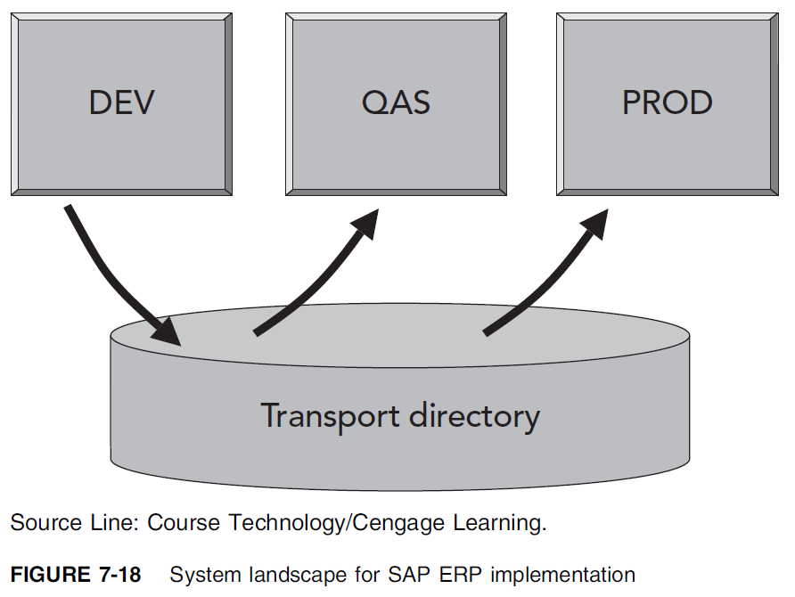
Konsep Landscape Sistem
Ada 3 SAP systems yang terpisah, untuk kebutuhan:
Development (DEV)
digunakan untuk mengembangkan pengaturan konfigurasi sistem, serta perangkat tambahan khusus menggunakan kode ABAP.
Quality Assurance (QAS), dan
Semua pengaturan, programs, dan perubahan diuji untuk memastikan berfungsi dengan baik.
Production (PROD)
Sistem yang digunakan perusahaan untuk menjalankan bisnis prosesnya.
Sumber: (Monk, 2013 Ch.7)
Notes:
• Software licensing fees—ERP software is quite expensive, and most ERP
vendors charge annual license fees based on the number of users.
• Consulting fees—ERP implementations require the use of consultants with
the skills to configure the software to support the company’s business
processes. Good consultants have extensive experience in the way ERP
systems function in practice, and they can help companies make decisions
that avoid excessive data input, while capturing the information necessary to
make managerial decisions.
• Project team member time—ERP projects require key people within the
company to guide the implementation. These are team members who have
detailed knowledge of the company’s business. They work closely with the
consultants to make sure the configuration of the ERP software supports the
company’s needs, which means these workers are frequently taken away
from their daily responsibilities.
• Employee training—Project team members need training in the ERP software
so they can work successfully with the consultants in the implementation.
Those team members also frequently work with training consultants to
develop and deliver company-specific training programs for all employees.
• Productivity losses—No matter how smoothly an ERP implementation goes,
companies normally lose productivity during the first weeks and months after
switching to a new ERP system.

Slide 25
ERP Life Cycle
$$\text{ERP} \text{Life} \text{Cycle}=ERP Implementation Life Cycle+ERP Support Life Cycle$$
Siklus hidup implementasi ERP
Seluruh aktivitas yang diperlukan dalam proyek ERP
Implementasi dibagi beberapa fase
Tidak ada ketentuan nama fase (seperti yang ada pada SDLC misalnya)
Siklus hidup dukungan ERP
Seluruh aktivitas yang diperlukan selama masa dukungan ERP
Sumber: (Ray, 2011 Ch.2)

Slide 26
ERP Life Cycle (Cont)
Pre- Implementation Phase
Aktivitas perencanaan, sebelum implementasi dilakukan
Project Preparation Phase
Memberikan perencanaan rinci proyek inisialisasi, dan persiapan proyek
Business Blueprinting Phase (Design Phase)
Mendeskripsikan detail fungsi bisnis dalam perusahaan
Menentukan kebutuhan teknis untuk membantu fungsi bisnis (business function) (lihat kembali perbedaan proses bisnis dan fungsi bisnis)
Realisation Phase
Membangun system dengan melakukan konfigurasi dan membangun spesifikasi bisnis. Didalamnya tercakup designing, bulinding dan testing.
Memastikan system lengkap, stabil dan siap untuk ditransfer ke system produksi (PROD System Landscape)
Final Preparation and Go Live Phase
Memastikan system siap untuk ditransfer pada hari H
Support Phase
Dilakukan setelah system Go Live.
Evaluasi system dan upgrading untuk versi berikutnya.
Sumber: (Ray, 2011 Ch.2)

Slide 27
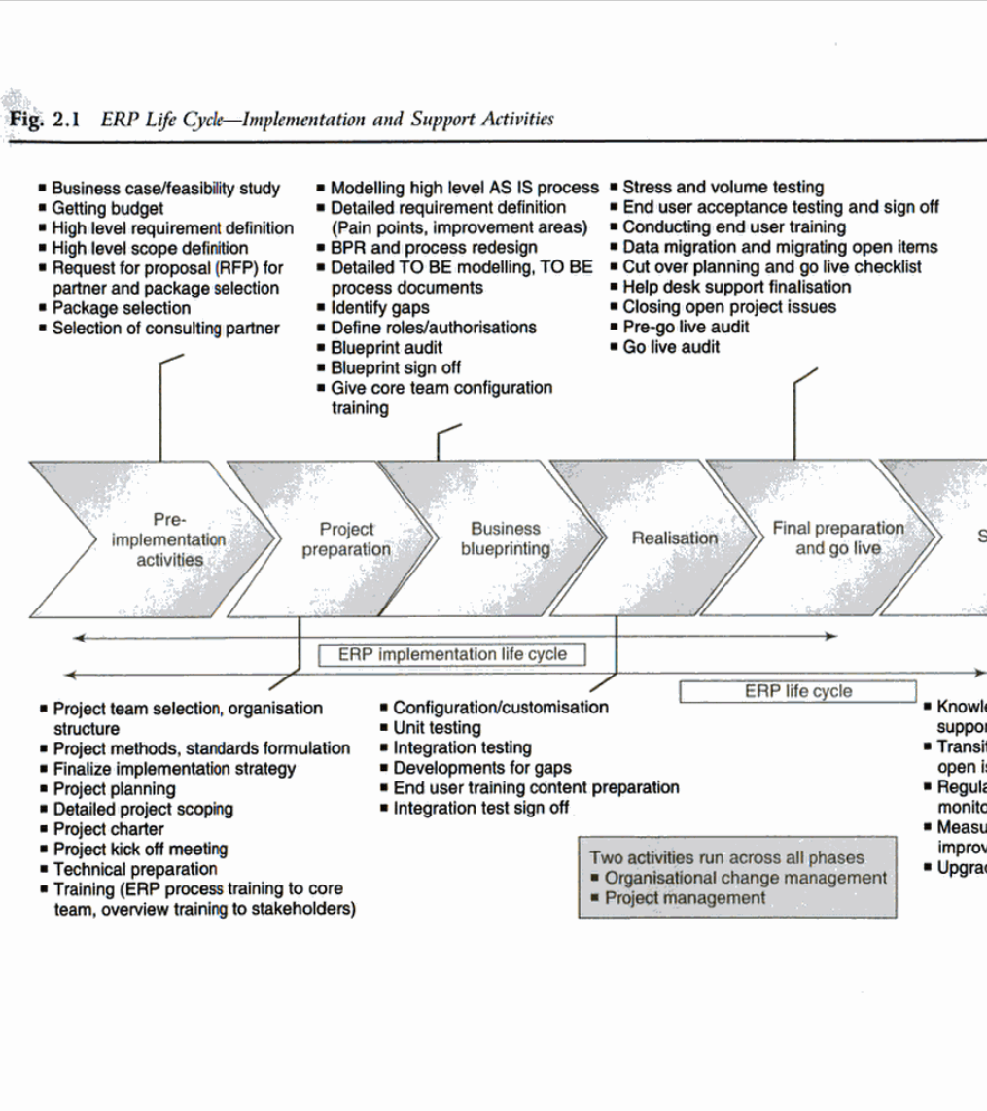
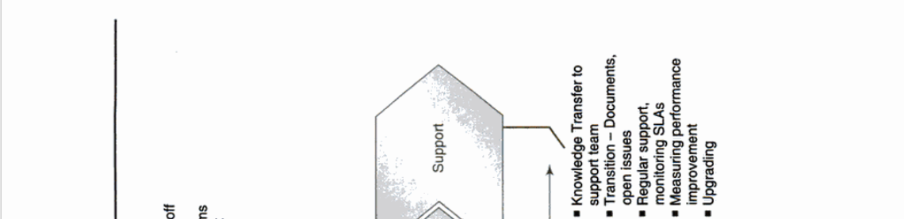
ERP Life Cycle (Cont)
Process Modelling
Process Improvement
Aktivitas pada tiap fase.
Sumber: (Ray, 2011 Ch.2)

Slide 28
Strategi Implementasi ERP
Semua Modul
Rollout
BigBang
4 pendekatan untuk implementasi ERP
Big bang (semua lokasi, semua modul)
Rollout (Beberapa lokasi, semua modul)
Big Bang & Modular (semua lokasi, beberapa modul)
Rollout & Modular (beberapa lokasi, beberapa modul)
Risk
Time
Learning Scope
Change Mgmnt
Resource Demand
Risk
Time
Learning Scope
Change Mgmnt
Resource Demand
Beberapa Lokasi
Semua Lokasi
Rollout & Modular
BigBang & Modular
Risk
Time
Learning Scope
Change Mgmnt
Resource Demand
Risk
Time
Learning Scope
Change Mgmnt
Resource Demand
Beberapa Modul
Sumber: (Ray, 2011 Ch.2)
Notes:
• Software licensing fees—ERP software is quite expensive, and most ERP
vendors charge annual license fees based on the number of users.
• Consulting fees—ERP implementations require the use of consultants with
the skills to configure the software to support the company’s business
processes. Good consultants have extensive experience in the way ERP
systems function in practice, and they can help companies make decisions
that avoid excessive data input, while capturing the information necessary to
make managerial decisions.
• Project team member time—ERP projects require key people within the
company to guide the implementation. These are team members who have
detailed knowledge of the company’s business. They work closely with the
consultants to make sure the configuration of the ERP software supports the
company’s needs, which means these workers are frequently taken away
from their daily responsibilities.
• Employee training—Project team members need training in the ERP software
so they can work successfully with the consultants in the implementation.
Those team members also frequently work with training consultants to
develop and deliver company-specific training programs for all employees.
• Productivity losses—No matter how smoothly an ERP implementation goes,
companies normally lose productivity during the first weeks and months after
switching to a new ERP system.

Slide 29
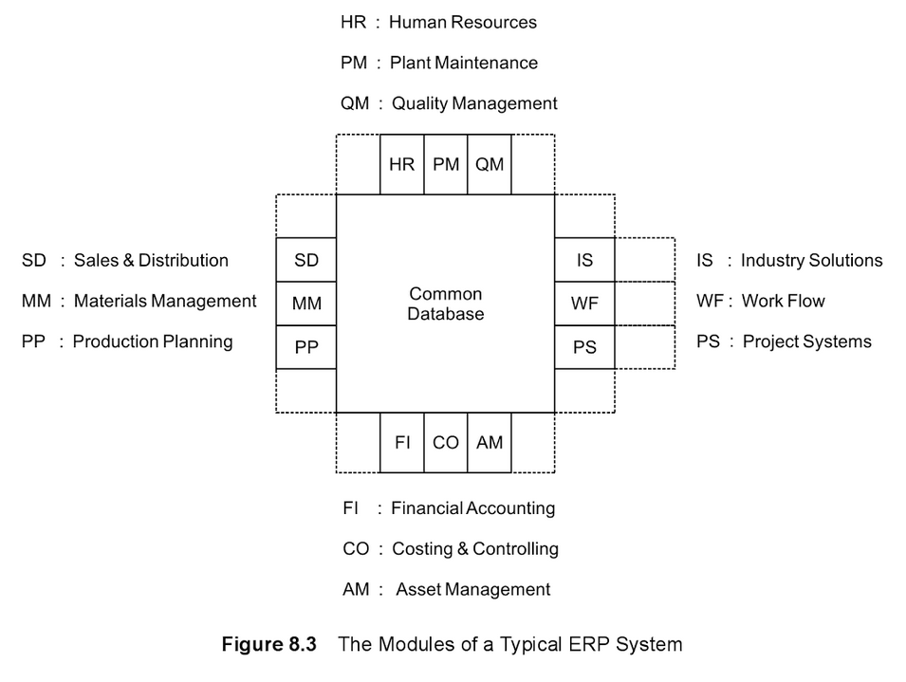
Review: Modul dalam ERP
SD Module: Sales Order and Delivery
MM Module: purchasing raw material, handling inventory
PP Module: capacity planning, daily production schedule
QM Module: Plan and records quality control activities
PM Module: maintenance plant machinery
AM Module: plant & machinery purchase and depreciation
HR Module: recruiting, hiring, training, payroll
PS Module: planning and control project e.q. R&D project, IT Project
FI Module, CO Module, WF Module
Sumber: (Goyal, Ch.8)

Slide 30
Pendekatan Big Bang
Perusahaan mengimplementasi semua Modul ERP dalam 1x Proyek untuk semua lokasi
Pendekatan umum untuk perusahaan kecil, tetapi tidak umum untuk implementasi ERP dengan ukuran besar
Keuntungan:
Kebutuhan waktu dan biaya berkurang
Kekurangan:
Resiko kegagalan tinggi
Kebutuhan tim implementasi dari pegawai senior tinggi dan pada saat yang sama, sehingga berat untuk menjalankan operasional bisnis perusahaan yang sedang berjalan.
Tidak dapat belajar dari implementasi di lokasi sebelumnya
Sumber: (Ray, 2011 Ch.2)

Slide 31
Pendekatan Rollout
Perusahaan mengimplementasi semua Modul ERP untuk satu (1) lokasi.
Pemilihan lokasi: perwakilan untuk seluruh bisnis proses perusahaan
Lokasi ini akan menjadi template global yang mencakup seluruh bisnis proses perusahaan
Template ini akan digulirkan (rollout) ke lokasi lainnya.
Dapat dilakukan penyesuaian sesuai kebutuhan spesifik lokasi
Keuntungan:
Resiko kegagalan kecil
Dapat belajar dari implementasi di lokasi sebelumnya
Kebutuhan tim implementasi dari pegawai senior tidak terlalu tinggi, sehingga tidak berat untuk menjalankan operasional bisnis perusahaan yang sedang berjalan.
Kekurangan:
Kebutuhan waktu lama
Sumber: (Ray, 2011 Ch.2)

Slide 32
Pendekatan Big Bang & Modular
Perusahaan mengimplementasi beberapa Modul ERP untuk semua lokasi.
Modul:
Transaksi dasar, cth . Modul Finance (FI), Modul Material Management MM (Procurement), Modul Sales and Distribution (SD)
Sumber: (Ray, 2011 Ch.2)

Slide 33
Pendekatan Rollout & Modular
Konsep yang sama dengan Rollout
Template ini akan digulirkan (rollout) ke lokasi lainnya,
Tetapi hanya untuk beberapa Modul Transaksi dasar
Keuntungan:
Resiko kegagalan paling kecil
Dapat belajar dari implementasi di lokasi sebelumnya
Kekurangan:
Kebutuhan waktu lama
Sumber: (Ray, 2011 Ch.2)

Slide 34
Daftar Pustaka
Monk, Ellen F., and Bret J. Wagner. 2012. Concepts in Enterprise Resource Planning. Fourth Edition. Course Technology. https://books.google.co.id/books?id=AWAJAAAAQBAJ.
Ray , Rajesh. 2011. Enterprise Resource Planning. New Delhi: Tata McGraw-Hill India. https://books.google.co.id/books?id=52KPTrtm__QC
Goyal, D.P. 2014. Management Information Systems: Managerial Perspectives, 4th Edition. Vikas Publishing House. https://books.google.co.id/books?id=ZaNDDAAAQBAJ

